Slide 1
Introduction to Databases

Slide 2
Version Control and Revision History
 | Name | Date
Prepared By | Manisha Mane | 27-Jul-2018
Reviewed By | Nisha Mendonsa | 27-Jul-2018
Approved By | Gauresh Gaitonde | 27-Jul-2018
Version No. | Date | Section Affected | Highlight of Changes
1.0.0 | 23-Mar-2017 | All | Original Version.
2.0.0 | 27-Jul-2018 | None | Annual Review 2018. No changes made.

Slide 3








Iconic Representations.......
Test your Memory
Can you Solve?
Objective
Coffee Break
Queries
Recap
Need more Info
Brainstorm

Slide 4

Objectives
The objective of this session is to make participants understand the Database Concepts and enable to design the Database Schema

Slide 5
Contents
Database Fundamentals
Database Views and Users
Data Models
Normalization
Notes:
Internet - a global network of computer networks that use standard protocols to exchange information, the largest network of computer networks.
World Wide Web - the network of HTML files stored on Web servers and interlinked with hyperlinks, thereby creating a "web" of interlinked files
URL - the address of a Web page consist of (Protocols, Hostname and DNS, IP Address, Port number)
Domain Name - names used in URL's and corresponding to one or more IP addresses. Domain names always carry a suffix, the top-level domain name such as com or edu. Domain names in a URL are case sensitive
Web server - a computer connected to the Internet that provides electronic files to other computers.
Browser - a software application used to access the World Wide Web and view web pages
HTTP - the protocol computers use to transmit Web documents between computers, identified by the prefix "http://" of the URL
ISP - companies that sell access to the Internet to other users.

Slide 6
Introduction to Database
DB - A set of inter-related data
MS - A software that manages the data
SCHEMA - A set of tables and relationships, which meet a specific need
ENDUSER TOOLS
DBMS
DATA
END USER
END USER
APPLICATIONS

Slide 7
Database Administrator
Is a database architect who is responsible for design and implementation of new databases.
Manages the database centrally
Decides on the type of data, internal structures and their relationships
Ensures the security of the database
Controls access to the data through the user codes and passwords
Can restrict the views or operations that the users can perform on the database.

Slide 8
Characteristics of DBMS
Control of Data Redundancy
Same data is stored at number of places
DBMS helps in removing redundancies by providing means of integration.
Sharing of Data
DBMS allow many applications to share the data.
Maintenance of Integrity
Refers to the correctness, consistency and interrelationship of data with respect to the application, which uses the data.

Slide 9
Characteristics of DBMS
Support for Transaction Control and Recovery
DBMS ensures that updates take place physically after a logical transaction is complete.
Data Independence
In DBMS, the application programs are transparent to the physical organization and access techniques.
Availability of Productivity Tools
Tools like query language, screen and report painter and other 4GL tools are available.

Slide 10
Characteristics of DBMS
Control over Security
DBMS provide tools by which the DBA can ensure security of the database.
Hardware Independence
Most DBMS are available across hardware platforms and operating systems.

Slide 11
Levels of Abstraction
Conceptual Level :-the overall integrated structural organization of the database
Physical Level :- the information about how the database is actually stored in the disk.
View / External Level :- the user view of the database. Different for different user based on application requirement.

Slide 12
The Data Model
Data model defines the range of data structures supported and the availability of data handling languages
It is a collection of conceptual tools to describe:
Data
Data relationships
Constraints
There are different data models:
Hierarchical Model
Network Model
Relational Model
Notes:
What is A Data Model
A data model is a conceptual representation of the data structures that are required by a database. The data structures include the data objects, the associations between data objects, and the rules which govern operations on the objects. As the name implies, the data model focuses on what data is required and how it should be organized rather than what operations will be performed on the data. To use a common analogy, the data model is equivalent to an architect's building plans.
A data model is independent of hardware or software constraints. Rather than try to represent the data as a database would see it, the data model focuses on representing the data as the user sees it in the "real world". It serves as a bridge between the concepts that make up real-world events and processes and the physical representation of those concepts in a database.

Slide 13
Contd…
What is A Data Model
A data model is a conceptual representation of the data structures that are required by a database. The data structures include the data objects, the associations between data objects, and the rules which govern operations on the objects. As the name implies, the data model focuses on what data is required and how it should be organized rather than what operations will be performed on the data.
To use a common analogy, the data model is equivalent to an architect's building plans.
A data model is independent of hardware or software constraints. Rather than try to represent the data as a database would see it, the data model focuses on representing the data as the user sees it in the "real world". It serves as a bridge between the concepts that make up real-world events and processes and the physical representation of those concepts in a database.

Slide 14
Contd…
To use a common analogy, the data model is equivalent to an architect's building plans.
A data model is independent of hardware or software constraints. Rather than try to represent the data as a database would see it, the data model focuses on representing the data as the user sees it in the "real world". It serves as a bridge between the concepts that make up real-world events and processes and the physical representation of those concepts in a database.

Slide 15
Contd…
Why is Data Modeling Important?
The goal of the data model is to make sure that the all data objects required by the database are completely and accurately represented. Because the data model uses easily understood notations and natural language , it can be reviewed and verified as correct by the end-users.
The data model is also detailed enough to be used by the database developers to use as a "blueprint" for building the physical database. The information contained in the data model will be used to define the relational tables, primary and foreign keys, stored procedures, and triggers. A poorly designed database will require more time in the long-term. Without careful planning you may create a database that omits data required to create critical reports, produces results that are incorrect or inconsistent, and is unable to accommodate changes in the user's requirements.

Slide 16
Hierarchical Structure
In this model data is represented by simple tree structure
Relationships between entities are represented as parent-child.
Many-to-many relationships are not allowed.
Parents and children are tied together by links called "pointers"
Root
Level 1
Child
Level 1
Child
Level 2
Child
Level 2
Child
Level 2
Child
Level 2
Child

Slide 17
The Hierarchical Model
Consider a student course - marks database
In the hierarchical model a student can register for many courses and gets marks for each course.
A parent can have many children
A child cannot have more than one parent
No child can exist without its parent
Scode
Sname
S1
A
Scode
Sname
Ccode
Cname
Marks
S2
B
C1
Physics
65
Ccode
Cname
Marks
C2
Chemistry
78
C3
Maths
83
C3
Maths
83
C4
Biology
85
C4
Biology
85

Slide 18
Possibilities in Hierarchical Model
INSERT
Insertion of Dummy student required to introduce a new course.
DELETE
Deleting a student- the only one to take the course deletes course information.
UPDATE
To change the course name of one course, the whole database has to be searched, this may result in data inconsistency.

Slide 19
The Network Model
Network model solves the problem of data redundancy by representing relationships in terms of sets rather than hierarchy
A record occurrence may have any number of immediate superiors
Network model supports many-to-many relationships

Slide 20
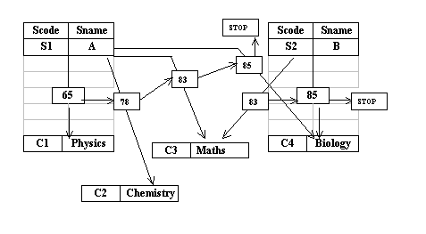
The Network Model
The student and course records are linked together through a marks record
No restrictions on number of parents
Record type can have number of parent and child record types
It is more complex than the hierarchical model because of links
Is a superset of the hierarchical model

Slide 21
Possibilities in Network Model
INSERT
Inserting a course record or student record poses no problems as they can exist without any connectors till a student takes the course.
DELETE
Deleting any record automatically adjusts the chain
UPDATE
Update can be done only to a particular child record

Slide 22
The Relational Model
The Relational Model developed out of the work done by Dr. E. F. Codd at IBM in the late 1960s who was looking for ways to solve the problems with the existing models.
At the core of the relational model is the concept of a table (also called a relation) in which all data is stored.
Each table is made up of records (horizontal rows also known as tuples) and fields (vertical columns also known as attributes).
Examples of RDBMS are Oracle, Informix, and Sybase.

Slide 23
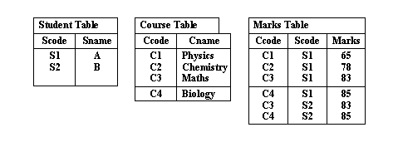
The Relational Model
Because of lack of linkages relational model is easier to understand and implement.

Slide 24
Possibilities in Relational Model
INSERT
Inserting a course record or student record poses no problems because tables are separate
DELETE
Deleting any record affects only a particular table
UPDATE
Update can be done only to a particular table

Slide 25
Relational DBMS
Examples of Relational Tables
DEPT table
Deptno Dname Loc
10 Accounting New York
20 Research Dallas
30 Sales Chicago ß 'row' or 'tuple'
40 Operations Boston
á
'column' or 'attribute'
EMPLOYEE table
Empno Empname Job Mgr Deptno
7369 Smith Clerk 7902 20
7499 Allen Salesman 7839 30
7566 Jones Manager 7839 20
7839 King President 10
7902 Ford Analyst 7566 20

Slide 26
Properties of Relational Data Structures
Tables must satisfy the following properties to be classified as relational.
Entries of attributes are single valued
Entries of attribute are of the same kind.
No two rows are identical
The order of attributes is unimportant
The order of rows is unimportant
Every column can be uniquely identified.

Slide 27
Data Integrity
Data integrity is the assurance that data is consistent, correct, and accessible
Entity Integrity:
Entity integrity ensures that no records are duplicated and that no attributes that make up the primary key are NULL
It is one of the properties necessary to ensure the consistency of the database.
Foreign Key and Referential Integrity
The referential integrity rule : If a foreign key in table A refers to the primary key in table B, then every value of the foreign key in table A must be null or must be available in table B

Slide 28
Data Integrity (Cont…)
Unique Constraint:
A unique constraint is a single field or combination of fields that uniquely defines a tuple/row
Unique constraints ensure that every value in the specified key is unique
A table can have any number of unique constraints, with at most one unique constraint defined as a primary key
A unique constraint can contain NULL value.

Slide 29
Data Integrity (Cont…)
DEPT table
Deptno Dname Loc
Accounting New York
20 Research Dallas
EMPLOYEE table
Empno Empname Job Mgr Deptno
7369 Smith Clerk 7902 20
7499 Allen Salesman 7839 30
Column Constraints : Specify restrictions on the values a column can take

Slide 30
Normalization

Slide 31
Normalization
is a technique for designing relational database tables
minimize duplication of information
safeguard the database against certain types of problems
Process of efficiently organizing data in a database
Goals of the normalization process:
eliminate redundant data
ensure data dependencies make sense
reduces the amount of space a database consumed
ensures that data is logically stored.

Slide 32
Problems with Unnormalized Database
can suffer from logical inconsistencies of various types and from anomalies involving data operations.
UPDATE ANOMALY
INSERTION ANOMALY
DELETION ANOMALY

Slide 33
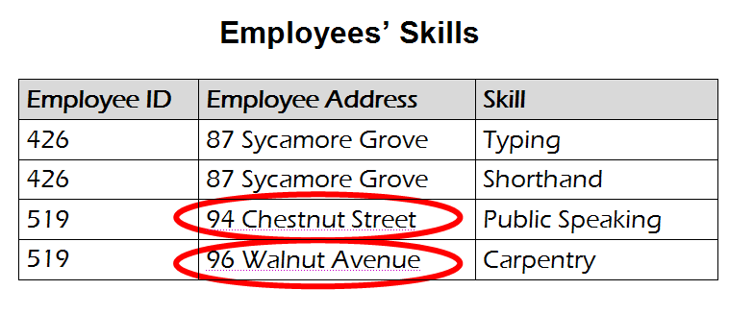
Example: UPDATE ANOMALY
An update anomaly. Employee 519 is shown as
having different addresses on different records

Slide 34
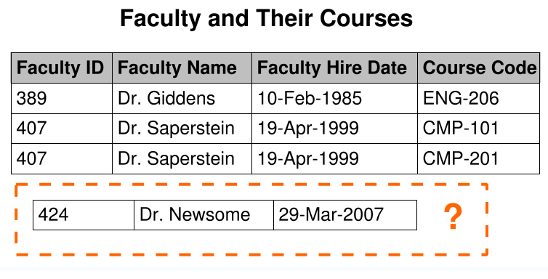
Example: INSERTION ANOMALY
An insertion anomaly. Until the new faculty member is assigned
to teach at least one course, his details cannot be recorded.

Slide 35
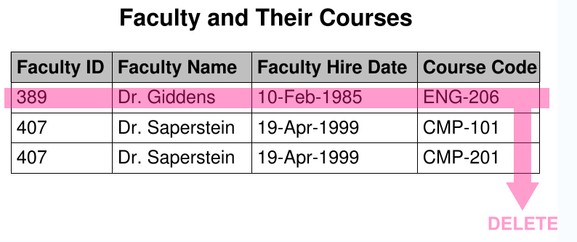
Example: DELETION ANOMALY
A deletion anomaly. All information about Dr. Giddens is lost when
he temporarily ceases to be assigned to any courses

Slide 36
Background to normalization:
Functional dependency
Trivial functional dependency
Transitive dependency
Multivalued dependency
Join dependency
Super key
Candidate key
Non-prime attribute
Primary key

Slide 37
Purpose of the Normalization
no duplication of data
no unnecessary data stored within a Database.
All the attributes (columns) of a table are completely dependent on the primary key of a table only and not on any other attribute.
Two important properties of Normalization:
Lossless Join Property
Dependency Preservation Property

Slide 38
Normal forms (abbrev. NF)
provides criteria for determining a table's degree of vulnerability to logical inconsistencies and anomalies.
The higher the NF applicable to a table, the less vulnerable it is to inconsistencies and anomalies
Normal Forms – Anomalies and Data Redundancies
A number of NF have been defined for classifying relations.
has associated with the relation.
Are used to ensure the various types of anomalies and inconsistencies

Slide 39
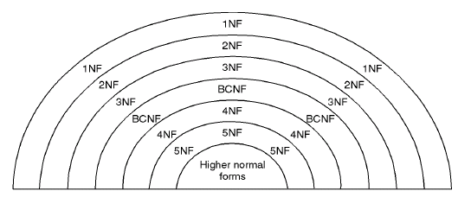
Relationship between Normal Forms

Slide 40
Unnormalized Relation
A table that contains one or more repeating groups.
To create an unnormalized table transform the data from the information source (e.g. form) into table format with columns and rows.

Slide 41

Unnormalized relation contains non atomic values
Below unnormalized table shows the preferences that student registers for various classes
Each row may contain non-atomic values

Slide 42
First Normal Form (1NF)
Eliminate Repeating Groups - Make a separate table for each set of related attributes, and give each table a primary key.
1NF requires that the values in each column of a table are atomic. By atomic we mean that there are no sets of values within a column.
A table is in first normal form (1NF) if and only if it faithfully represents a relation.
a table with a unique key and without any nullable columns is in 1NF

Slide 43
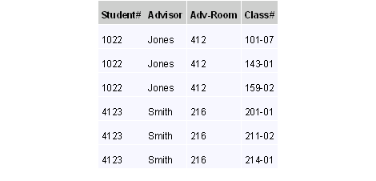
Example of First Normal form
unnormalized data is normalized to 1NF

Slide 44
Second Normal Form (2NF)
Is based on the concept of Full Functional Dependency.
A relation R is in 2NF if and only if it is in 1NF and every non-key attribute is fully functionally dependent on the primary key of the relation R.
Rules for 2NF
A table in 1NF is also in 2NF form if the values in every column are functionally or transitively dependent on the complete primary key
For every relation with a single data item making up the primary key, this rule should always be true. For those with the composite key examine every column and ask whether its value depends on the whole of the composite key or just some part of it
Remove those that depend only on part of the key to a new relation with that part as the primary key

Slide 45
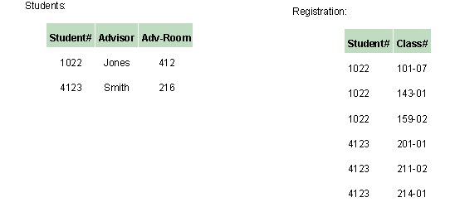
Example of 2NF form
The below two tables demonstrate 2NF.
Note the multiple Class# values for each Student# value in the above table. Class# is not functionally dependent on Student# (primary key), so this relationship is not in 2NF.

Slide 46
Example for 2nf
Let’s consider relation Emp_proj has the following structures with the following FDs:
Emp_Proj (SSN, Pnumber, Hours, Ename, Pname, Plocation)
SSN -> Ename
Pnumber -> {Pname, Plocation}
{SSN,Pnumber} -> Hours
{SSN,Pnumber} -> Ename

Slide 47
Contd…
In the above set of FDs for the relation Emp_Proj the attribute Ename is partially dependent on {SSN,Pnumber} because SS Ename also holds. Therefore Ename is not fully functionally dependent on SSN.
So we decompose this table to arrive at set of relations, in a state as defined by second normal form. Thus the above table EMP_PROJ gets decomposed in the following three relations say EP1, EP2 and EP3.
EP1 (SSN, PNUMBER, HOURS) {SSN,PNUMBER} -> HOURS
EP2 (SSN,ENAME) SSN->ENAME
EP3 (PNUMBER,PNAME,PLOCATION) PNUMBER->{PNAME,PLOCATION}

Slide 48
Third Normal form
Eliminate Columns Not Dependent On Key - If attributes do not contribute to a description of the key, remove them to a separate table
3nF is based on the concept of transitive dependency.
A relation R is in 3NF if and only if it is in 2NF and every non-key attribute is nontransitively dependent on the primary key of the relation R.

Slide 49
The criteria for third normal form (3NF)
Rules :
A relation in the second normal form is also in the third normal form, if the values in every non - key column are not transitively dependent on the primary key
Examine every non - key column and question its relationship with every other non - key column
If there is a transitive dependency remove both the columns to a new relation

Slide 50
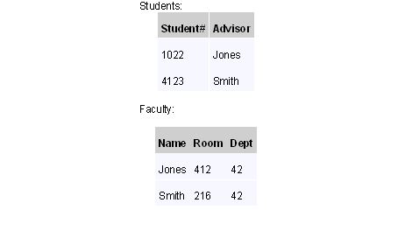
Example of Third Normal form
In the last example, Adv-Room (the advisor's office number) is functionally dependent on the Advisor attribute.
move that attribute from the Students table to the Faculty table, as shown below:

Slide 51
Example for 3NF
Let’s consider relation Emp_dept has the following structures with the following FDs:
Emp_dept (Ename,SSN, Bdate, Address,Dnumber,Dname,DMGRSSN)
SSN -> Ename
SSN -> Bdate
SSN -> DNumber
DNumber -> Dname
DNumber -> DMGRSSN

Slide 52
Contd…
In the above relation Emp_dept the dependency SSN->DMGRSSN is transitive as both the dependencies SSN->Dnumber and Dnumber->DMGRSSN holds and Dnumber is neither a key itself nor a subset of Emp_dept.
So we decompose this table to arrive at set of relations, in a state as defined by third normal form. Thus the above table EMP_PROJ gets decomposed in the following two relations say EP1 and EP2.
EP1 (Ename,SSN, Bdate,Address,Dnumber) SSN->{Ename,BDate,Address,DNumber}
EP2 (Dnumber,Dname,DMGRSSN)
Dnumber->{Dname,DMGRSSN}

Slide 53

Contd…
this relation has redundancies wherein If the name of the employee is changed, the change will have to be made in every tuple of the relation, otherwise inconsistencies will creep up.
The table will further have to be decomposed to eliminate dependencies between the candidate key columns as shown,

Slide 54
BENEFITS OF NORMALIZATION
Greater overall database organization
Reduction of redundant data
Data consistency within the database
A much more flexible database design
A better handle on database security

Slide 55
DRAWBACKS OF NORMALIZATION
Reduced database performance
The acceptance of reduced performance requires the knowledge that when a query or transaction request is sent to the database
requires much more CPU, memory, and I/O to process transactions and database queries

Slide 56

Summary
RDBMS are primary used for storing transactional data.
E-R Model is prepared to map the business system to database.
Normalization is the process of refining the table schema.

Slide 57
Questions

